Slide 1
Linux Assignment
Presentation on
Memory Management in xv6
Presented By:
Om Prakash Sahoo
Sarthak Kaushik
Mihir Raj
21/03/2022

Slide 2
Terminology
VA : Virtual Address
PA : Physical Address
PD : Page Directory
PDE : Page Directory Entry
PT : Page Table
PTE : Page Table Entry
PPN : Physical Page Number

Slide 3
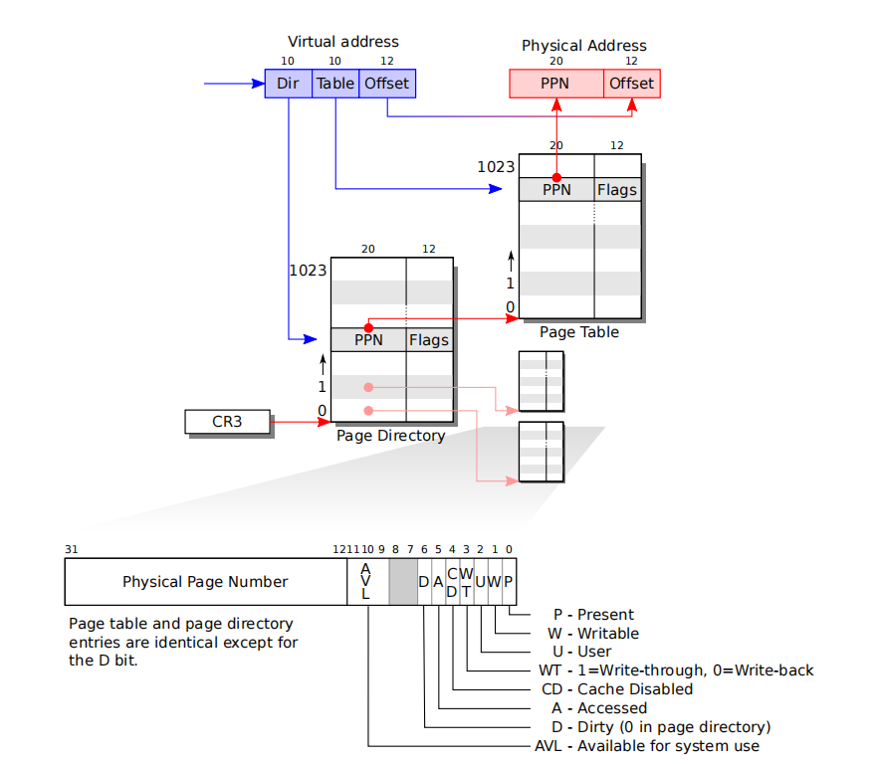
Overview of xv6 page table
xv6 uses 32-bit virtual addresses, resulting in a virtual address space of 4GB. 2^32 = 4GB(almost)
xv6 uses a page size of 4KB, and a two level page table structure.
The CPU register CR3 contains a pointer to the outer page directory of the current running process
The translation from virtual to physical addresses is performed by the x86 MMU
The first 10 bits of a 32-bit virtual address are used to index into the page table directory,which provides an address of the inner page table.
The next 10 bits index into the inner page table to locate the page table entry (PTE).

Slide 4
2 Level Page Translation
CR3 populated with pgdir
CR3/PTPR register holds the base address of outer page table.
*(CR3 + Dir) -> L1 page
L1 page holds the base address of inner page table
*(L1 + Table) ->L2 page
L2 page holds the 20 bits of physical address
Offset of virtual memory is directly copied to the physical address.

Slide 5
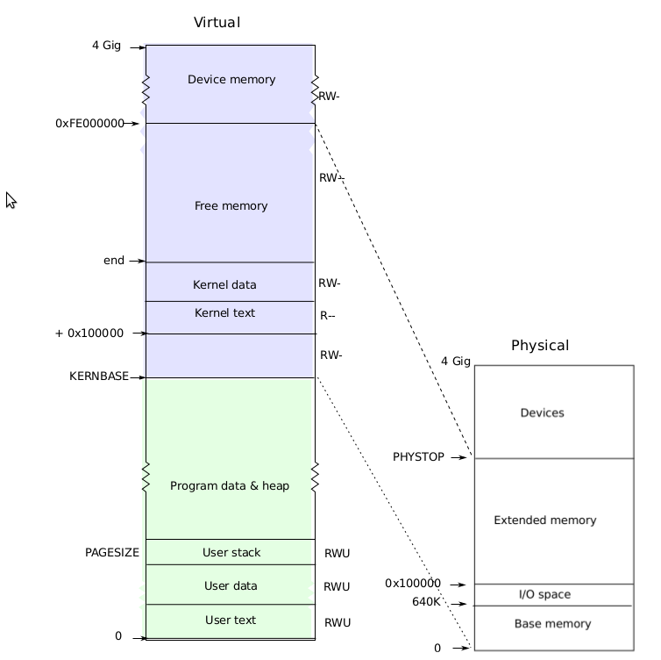
Memory Layout - Kernel Only memory
Each process has its own separate page table.
0 : KERNBASE is user virtual address range where thee memory is being used by the user program executing.
KERNBASE (0x8000 000) is for kernel use initialization.
Kernel actually does not start at KERNBASE, it starts a bit later at KERNLINK.
After KERNLINK, the space is used for kernel code and data.
It can be observed that even if the size of physical memory if 4GB, only 2GB can be used by xv6.
Physical is mapped like: 0 : PHYSTOP == KERNBASE : KERNBASE + PHYSTOP.

Slide 6
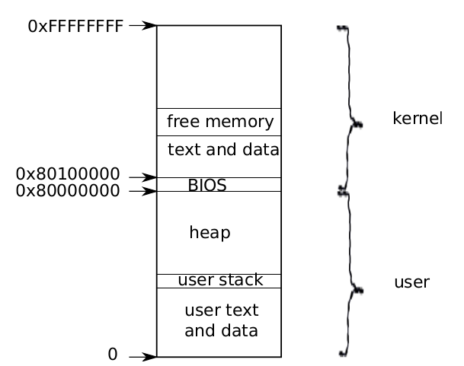
Kernel code is loaded into contiguous physical memory.
Next comes the kernel code and read only data.
Apart from these, the remaining memory is in the form of free pages managed by the kernel.
When user program requests to use user part of address space, the kernel allocates memory to the user process from the above free space list.
most physical memory can be mapped twice, once into the kernel part of the address space of a process, and once into the user part.
Kernel don’t completely uses the memory. It stops at PHYSTOP (the last address it can access).
The higher memory addresses are used for memory mapped I/O 32-bit devices.

Slide 7
Memory Layout - User Only memory
An address space includes the process’s user memory starting at virtual address zero(0) goes upto KERNBASE.
Instructions come first, followed by global variables, then the stack, and finally a ‘‘heap’’ area (for malloc) that the process can expand as needed.
Each process’s address space maps the kernel’s instructions and data as well as the user program’s memory.
This arrangement exists so that the kernel system call’s code can directly refer to user memory.

Slide 8
Memory Layout - User Only memory
In order to leave room for user memory to grow, xv6’s address spaces map the kernel at high addresses, starting at 0x80100000.
When the process is executing user instructions, only its user stack is in use, and its kernel stack is empty.
When the process enters the kernel (via a system call or interrupt), the kernel code executes on the process’s kernel stack.
While a process is in the kernel, its user stack still contains saved data, but isn’t actively used.
When a process makes a system call, the processor switches to the kernel stack, raises the hardware privilege level, and starts executing the kernel instructions that implement the system call.
When the system call completes, the kernel returns to userspace, the hardware lowers its privilege level, switches back to the user stack, and resumes executing user instructions just after the system call instruction.

Slide 9
References
zarif98sjs/xv6-memory-management-walkthrough: Walkthrough of Xv6 Memory Management (github.com)
Operating Systems : Memory Management (iitm.ac.in)

Slide 10
THANK YOU.

